Slide 1
Elimination
AEHBY ATAR Human Biology

Slide 2

Review
Sort the enzymes by source:
salivary glands, stomach, pancreas, small intestine.
Sort the enzymes by macromolecule:
carbs, proteins, lipids, nucleotides.
Sort the enzymes by pH:
neutral, basic, acidic

Slide 3
Review
4. Sketch a diagram to show the difference between the small intestine and large intestine at a microscopic level. Explain how the structure of each relates to its function.

Slide 4
Learning Intentions
Elimination removes undigested materials and some metabolic wastes from the body.

Slide 5
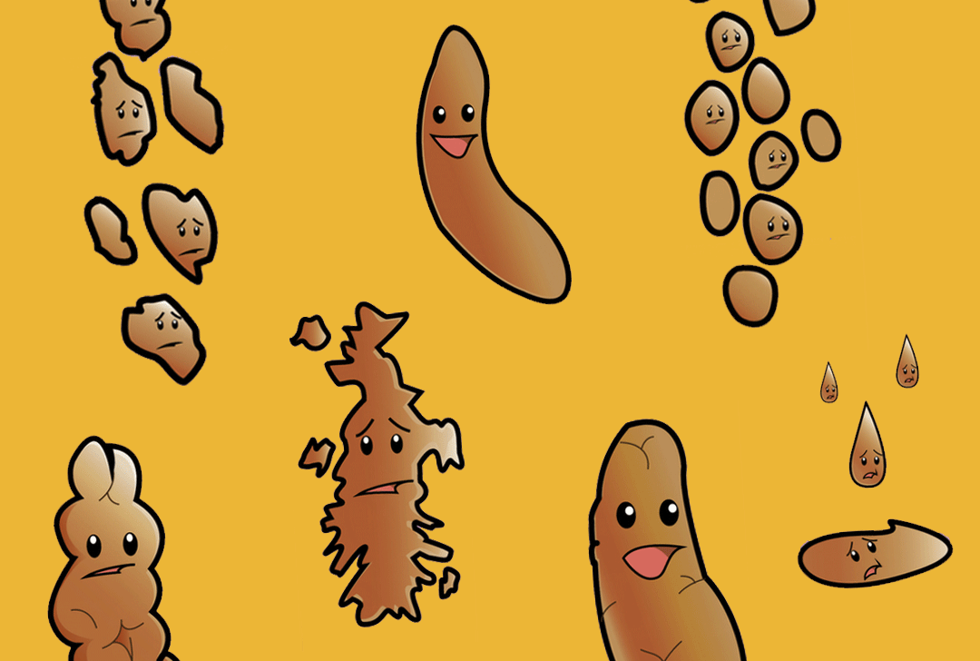
Success Criteria
Describe the role of the large intestine.
List the components of faeces.
Explain the difference between excretion and elimination.
Explain how diet affects absorption

Slide 6
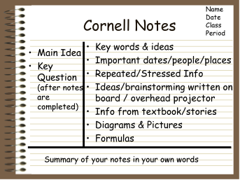

Slide 7
The large intestine
It takes approximately 18-24 hours for material to move through the large intestine. During this time, much of the remaining water is absorbed so the contents become more solid. Most nutrients have already been absorbed, although some bacterial digestion occurs, releasing vitamins for absorption.

Slide 8



Elimination
Large Intestine (LI)
18-24 hrs
water absorbed
Bacterial digestion
Some vitamins

Slide 9
Faeces
The semi-dried solid material left after water absorption and bacterial action makes up the faeces. It contains water, undigested food (especially cellulose) bacteria, bile pigments and remains of cells that have come away from the surface of the gastrointestinal lining.

Slide 10
Elimination
Large Intestine (LI)
Faeces
18-24 hrs
water absorbed
Bacterial digestion
Some vitamins
Semi-dried solid
Water, undigested food (cellulose), bacteria, bile pigments, cells

Slide 11
Elimination vs excretion
Excretion refers to removal of metabolic waste- waste that has been produced by body cells. Faeces has never been part of the body cells (except for bile pigments) so it can be thought of as the leftover materials of digestion that were never incorporated into the body in the first place. Defacation is therefore referred to as elimination rather than excretion.

Slide 12
Elimination
Large Intestine (LI)
Faeces
Defacation
18-24 hrs
water absorbed
Bacterial digestion
Some vitamins
Semi-dried solid
Water, undigested food (cellulose), bacteria, bile pigments, cells
Leftovers were never part of body cells
:. Elimination rather than excretion

Slide 13
Diet and absorption
The slower material moves through the gastrointestinal tract, the more nutrients and water are absorbed. Alcohol and caffeine stimulate the digestive system, and protein and fat slow movement. Constipation occurs if movements are too slow and too much water is absorbed. Insoluble fibre (undigestable cellulose) holds water and keeps things moving. Diarrhoea is frequent defacation of watery faeces, caused by irritation of the small or large intestine, for example by viral or bacterial infection. Faster peristalsis and movement and less water absorption cause severe dehydration.

Slide 14
Defacation
Diet
Leftovers were never part of body cells
:. Elimination rather than excretion
Slower = more water absorption
Alcohol + caffeine stim.
Insol. fibre holds water keeps moving
Diarrhoea (irritation) too fast -> dehydration

Slide 15
Success Criteria
Describe the role of the large intestine.
List the components of faeces.
Explain the difference between excretion and elimination.
Explain how diet affects absorption.

